Slide 1
Using Cases (and Games) to Teach Cybersecurity and Privacy
Paul John Steinbart
Nicholas Smith (EY)
2019 AIS Boot Camp: Cybersecurity
Accounting Information Systems Section - AAA
Atlanta, GA
21 May 2019

Slide 2

Objective: Reduce anxiety among accounting (and all business) students that cybersecurity is too technical to understand
Use cases to illustrate the myriad business decisions related to cybersecurity
Supplement with games (simulations)
Discuss relevant policy issues

Slide 3
Start with an interesting topic: ransomware
Harvard Business Case: When Hackers Turn to Blackmail
Sunnylake Hospital is being held up by online extortionists who have blocked access to its electronic medical records and are demanding $100,000 to restore it. Paul Layman, Sunnylake's CEO, didn't take their first e-mail seriously, and now the hospital has ground to a halt. Paul's golden-boy IT director can't seem to outwit the hackers. Sunnylake's legal counsel tells Paul, "Literally every second is a liability." The chief of staff is in a mutinous fury. What should Paul do? (from Case Abstract)
Drives home that security is not something left just to IT

Slide 4
Follow-up: research showing security is a Business issue
Steinbart, P.J., R.L. Raschke, G. Gal, and W.N. Dilla. 2018. “The influence of a good relationship between the internal audit and information security functions on information security outcomes,” Accounting, Organizations and Society (71): 15-29.
Quality of Relationship between
Internal Audit and
Information Security
Effectiveness of
Security Program
Top Management
Support for
Security

Slide 5
Discuss why security solutions are not just technical, but require a systems approach
Source: An Introduction to the Business Model for Information Security, ISACA, 2009 p. 14

Slide 6
Follow-up: more research, showing the behavioral side of security
Keith, M., B. Shao, and P.J. Steinbart. 2009. “A Behavioral Analysis of Passphrase Design and Effectiveness” Journal of the Association for Information Systems 10(2): 63-89. Available at http://aisel.aisnet.org/jais/vol10/iss2/2.
Steinbart, P.J., Keith, M., and Babb, J. 2016. “Examining the Continuance of Secure Behavior: A Longitudinal Field Study of Mobile Device Authentication,” Information Systems Research 27(2): 219-239.

Slide 7
Structure of course – the Security Life Cycle
Plan
Protect
Respond
Assess

Slide 8

Phase 1: Planning
Take inventory and value information resources
Threat Assessment
Create Policies
  Share practical tip: No need to “reinvent the wheel” when developing policies – visit the the “Security Policy Project” at sans.org
  https://www.sans.org/security-resources/policies/

Slide 9
Follow-up: mini-cases on policy
Fresh to Table (how to discipline employees who do not follow the organization’s values on social media)
Facebook Folly at Northeast BMW (how to discipline an employee who makes unflattering posts on social media)
Reign of Zero Tolerance (how to dismiss employees; how to communicate policies)

Slide 10
Phase 2: Protect
1. Risk Assessment and Response
  The time-based model of security: P > D + R
  Measuring the Total Cost of Solutions
  Measuring Benefits: Going Beyond Expected Loss
    Real cost savings
    Revenue growth
  Marginal Costs vs. Marginal Benefits
  Using Discounted Cash Flow Analysis instead of FUD

Slide 11
Follow-up: case on Security Investments
“Information Risk Analysis at Jeffords” (Dartmouth)
San Francisco International Airport and Quantum Secure’s SAFE for Aviation System (also includes a spreadsheet)
Secom: Managing Information Security in a Risky World
Simulation/game: “CyberProtect” by Department of Defense
http://iatraining.disa.mil/eta/cyber-protect/launchpage.htm

Slide 12
Phase 2: Protect
2. Technology Dive
  Network primer on TCP/IP
  Use Wireshark to demonstrate packet structure
  Dated, but humorous video follow-up: “Warriors of the Net” (YouTube)
3. Encryption, digital signatures, and blockchain

Slide 13
Phase 3: Respond
1. Incident Response – cases:
  The iPremier Company: Denial of Service Attack (graphic novel version)
  IT Management Simulation: Cyber Attack
2. Business Continuity and Change Management case:
  CareGroup

Slide 14
Phase 3: Respond
3. Privacy – cases:
  Dark Side of Customer Analytics – selling PI
  None of Our Business? – embedding RFID

Slide 15
Phase 4: Assess
Topic: How to measure security effectiveness
Exercise: building security scoreboards and dashboards

Slide 16
Supplemental Engagement: Discussion Board or In-Class Debates
Should SOX 404 reports include cyber-security?
Should software developers be liable for insecure coding practices (SQL injection, buffer overflows, etc.)?
Should opt-in become mandatory for all businesses that want to collect and use PI?

Slide 17
Assessing Student Learning
Case analyses (teams)
Quizzes (M/C – focus on terminology and principles)
Participation in discussion
Final exam (essays)

Slide 18
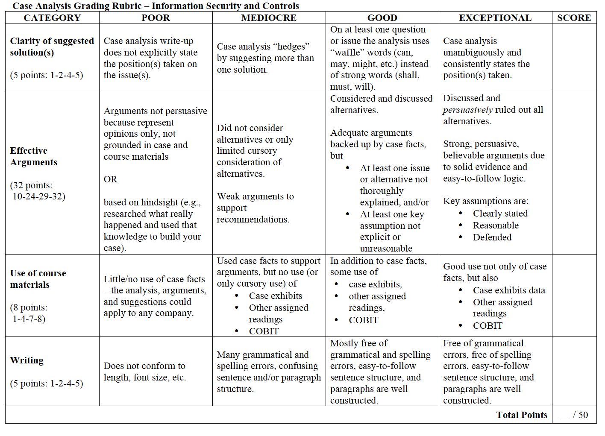
Assessing Student Learning

Slide 19
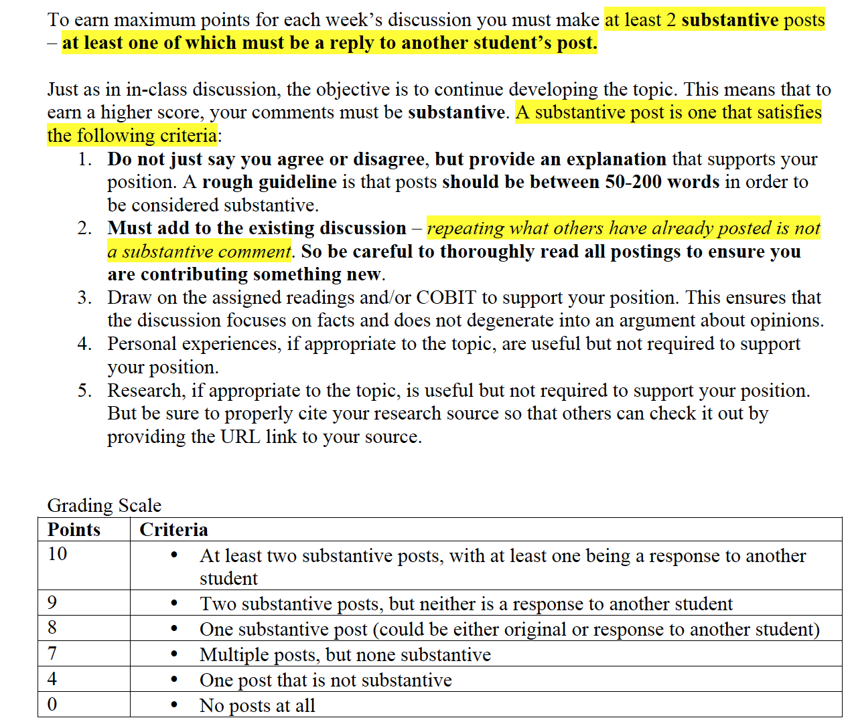
Assessing Student Learning

Slide 20
Take-away to ask students:
“What kind of manager will you be?
Some executives recognize the importance of information security to their companies without the immediate threat of government sanctions or lost customers. They generally work for companies that have a clear understanding of the value of their intellectual property and the lengths competitors will go to steal it. However, without such painful threats, most executives won’t spend the time and money it takes to address security proactively and comprehensively.
Source: Parenty, Digital Defense, Harvard Business Press, pp. 109-110

Slide 21
Questions?
Contact Information:
Paul.Steinbart@asu.edu

